Slide 1
EPESIANS

Slide 2
EPESIANS

Slide 3
EPESIANS
The 1st of the four Prison Epistles
Ephesians
Philippians
Colossians
Philemon

Slide 4
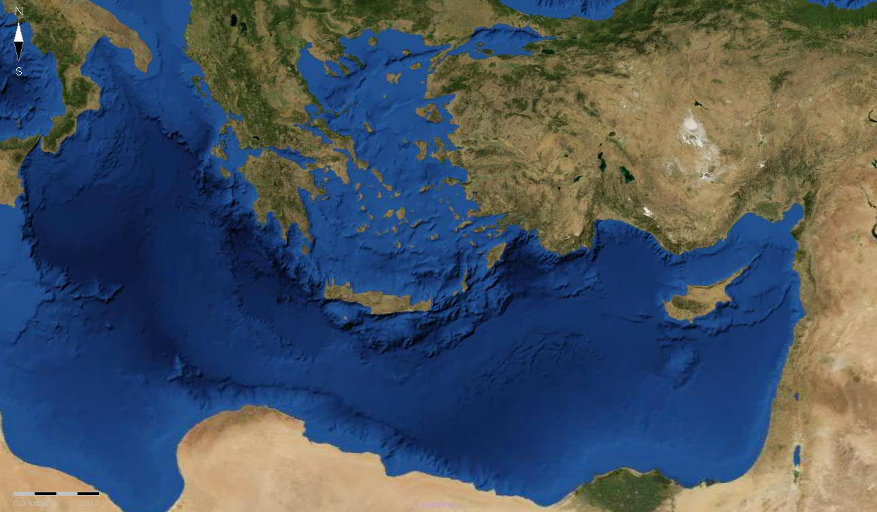
EPESIANS
Laodicea
Ephesus
Collosse

Slide 5
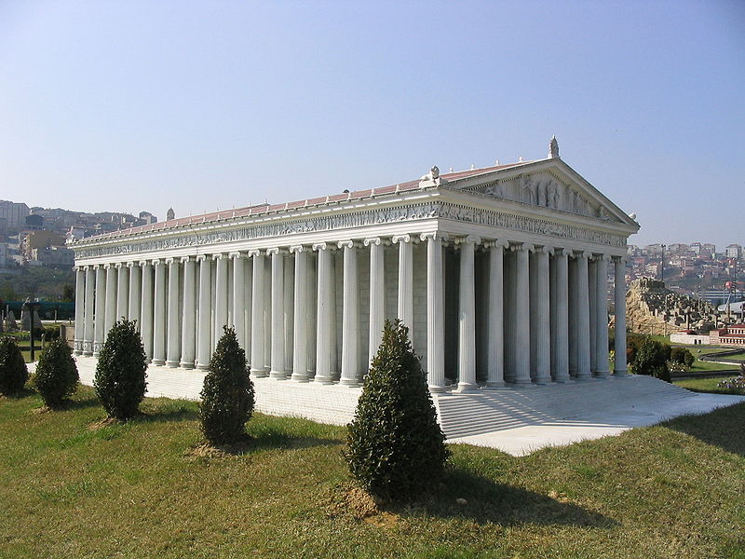
EPESIANS
Temple of Diana

Slide 6
EPESIANS
For a great and effective door has opened to me, and there are many adversaries.
1 Corinthians 16.9

Slide 7
EPESIANS
Chapters 1-3 ~ Doctrinal
Chapters 4-6 ~ Practical application

Slide 8
EPESIANS
Workmanship ~ poiēma
For since the creation of the world His invisible attributes are clearly seen, being under-
stood by the things that
are made, even His eternal
power and Godhead, so that
they are without excuse …
Romans 1.20

Slide 9
EPESIANS
Imitators ~ mimētēs

